Slide 1


Building Scalable IMS LTI Tools Using the TSUGI Framework
Charles Severance
www.dr-chuck.com
www.tsugi.org

Slide 2


2

Slide 3
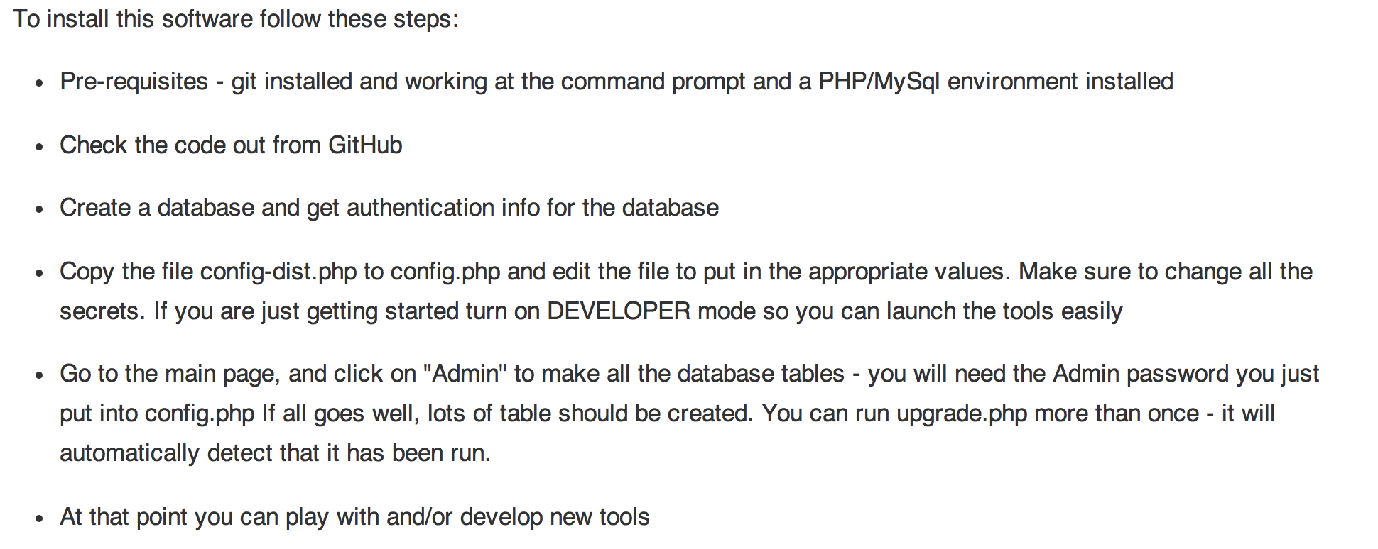
Installation Instructions
www.tsugi.org

Slide 4
Project Tsugi
Tool Hosting Container (i.e. Like a B2)
PHP now, Java in development
Based on IMS Specifications
LTI 1.x / LTI 2.x / IMS Settings / Common Cartridge / Caliper / CASA / Roster / Gradebook / ....
Tools can run on a campus hosting platform or commercial provider or cloud
Tools are "installed" into hosting containers

Slide 5
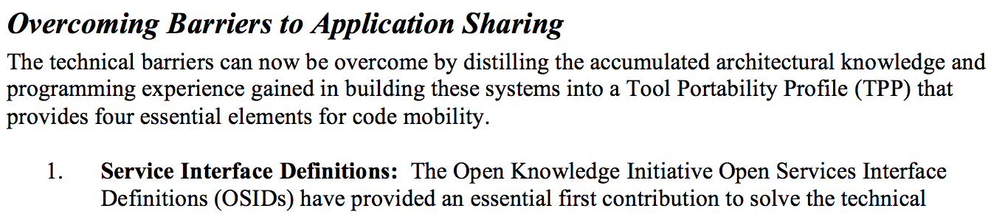
From the 2003 Sakai Proposal
http://www-personal.umich.edu/~csev/papers/2004/2004_03_01_mellon_sakai_proposal.pdf

Slide 6





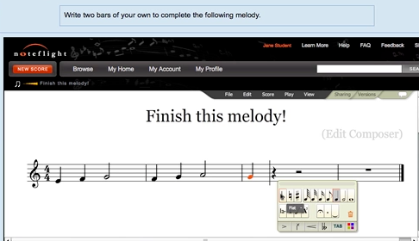




WTD?
...

Slide 7

L
T
I
PHP
Java
C#
...
But...

Slide 8






"Large Midwestern University"
Sakai
.......
Looks pretty cool.... But...

Slide 9
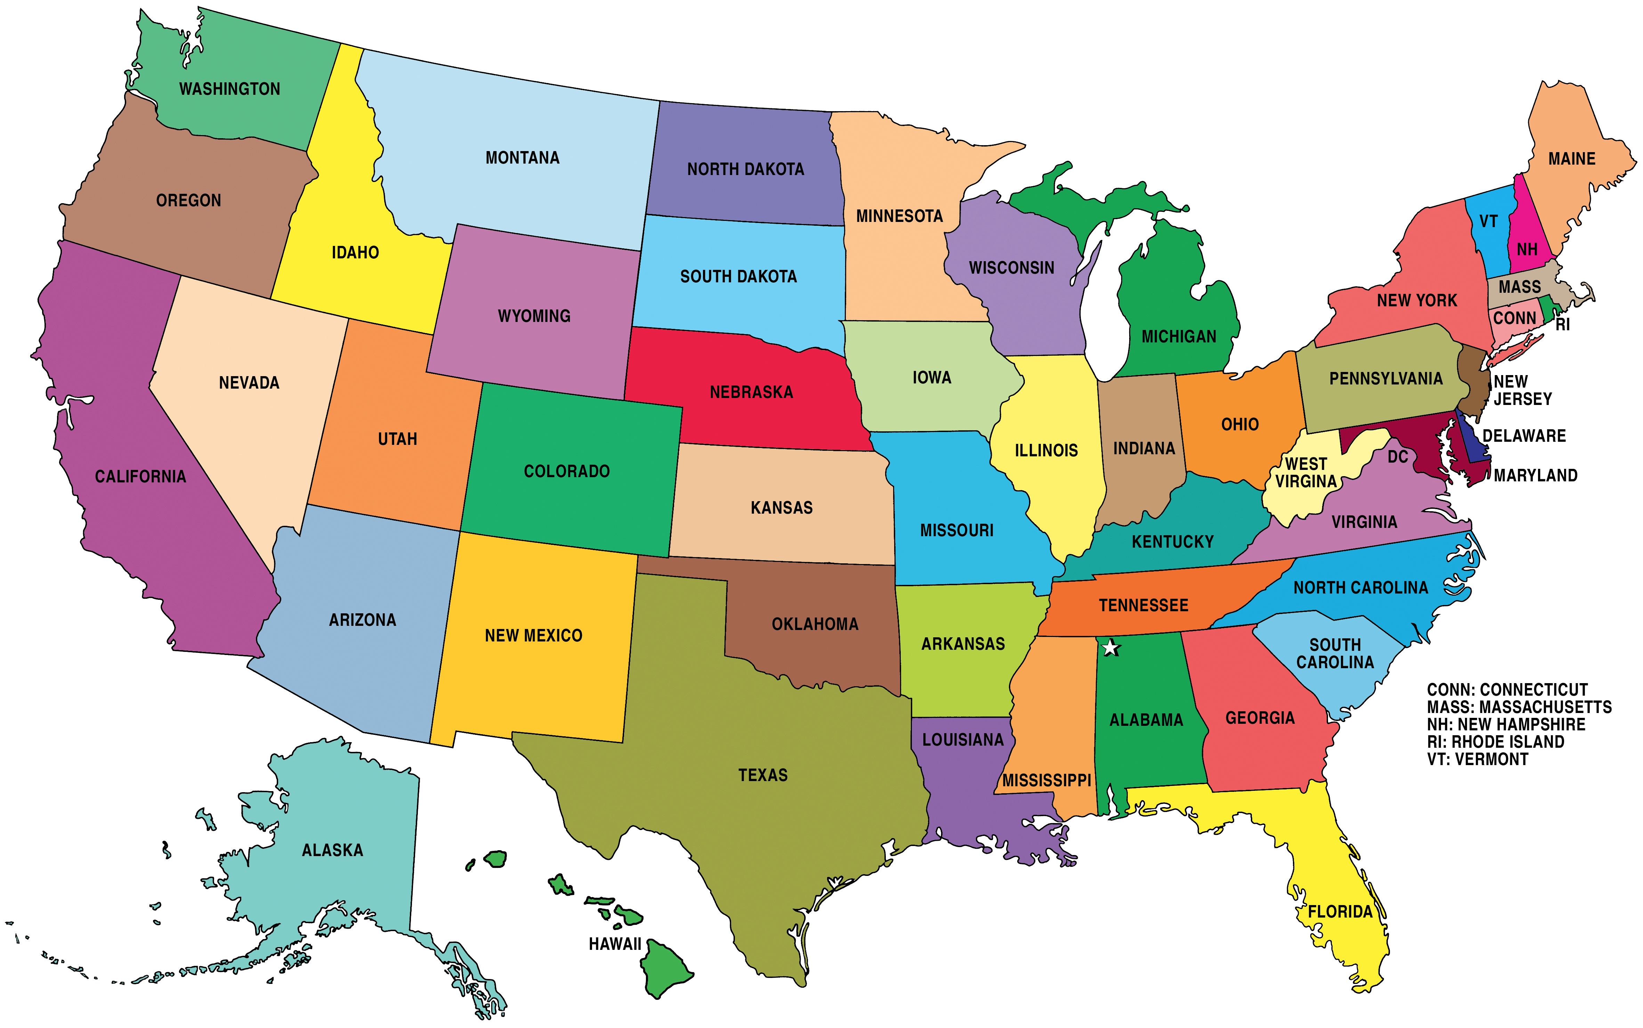
Sakai
Where is the user data??
What happens when there are 50 apps?
What if the app is free and hosted by a professor?
What happens if we stop paying the license?

Slide 10
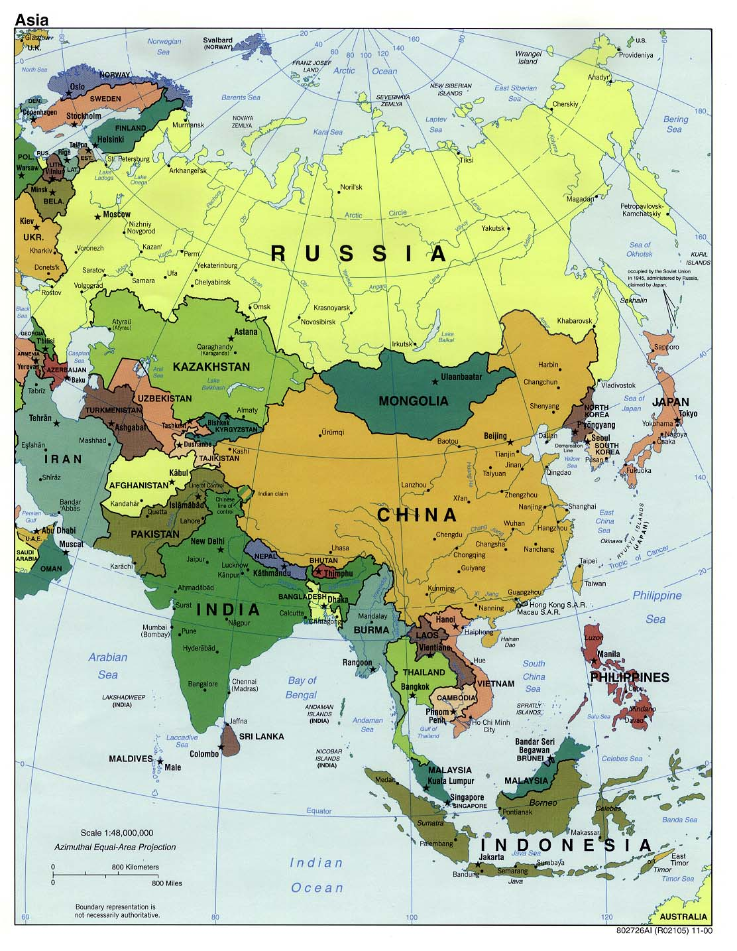
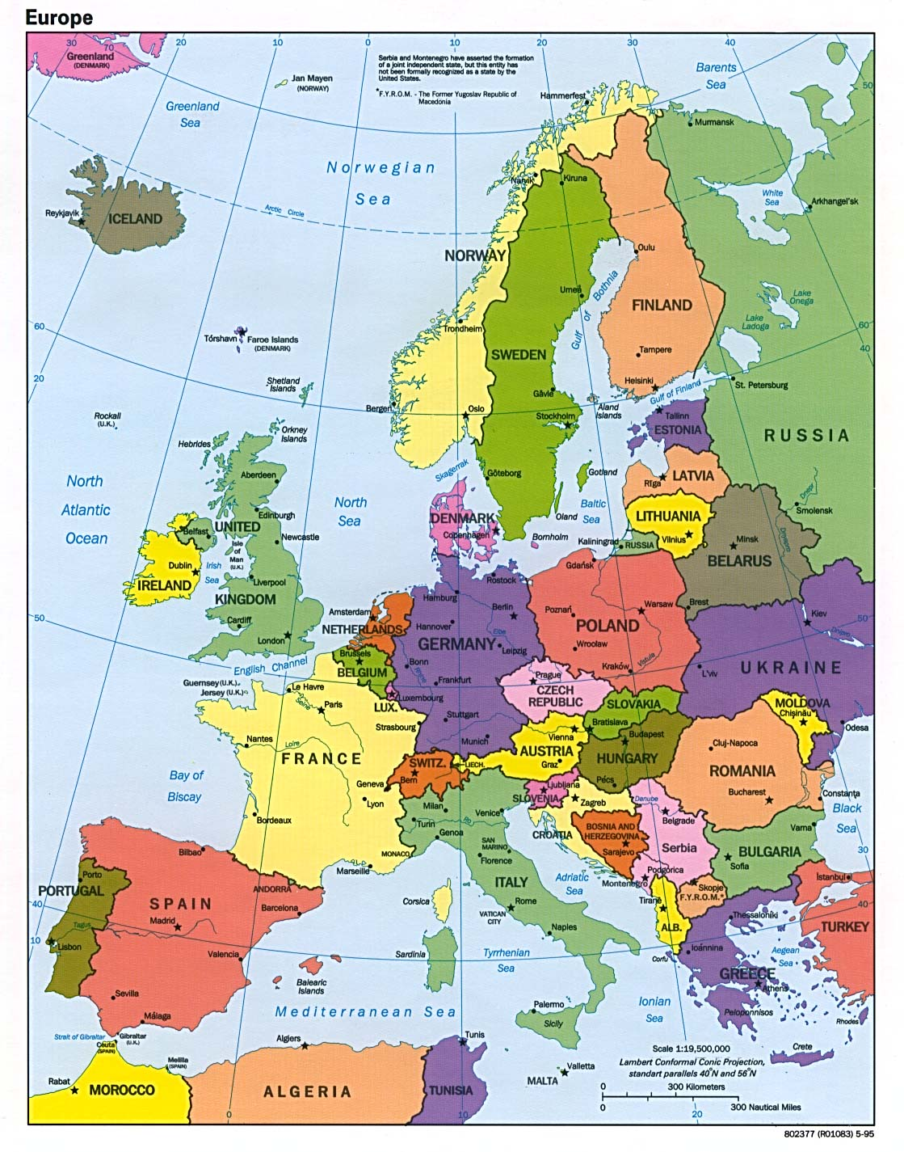
Neo-Colonialism
LTI-style

Slide 11
LTI 1.x versus LTI 2.x and Beyond
LTI 1.x – Three pages of spec and some "hello world" code
LTI 2.x – Several specs – multiple interactions
We will need to share common implementations across instructions
And what about Caliper, Casa, xAPI, etc. ??

Slide 12



Multiple LMS Campus + App Store
App
Store
Tool
Tool
Tool
Tool
...

Slide 13
Multiple LMS Campus + App Store
Tsugi
Hosting
Container
Tool
Tool
Tool
Install
App
Store
Tool
Tool
Tool
Tool
...

Slide 14
Multiple LMS Campus + App Store
Tsugi
Prod
Tsugi
Exp
Tool
Tool
Tool
App
Store
Tool
Tool
Tool
Tool
...

Slide 15
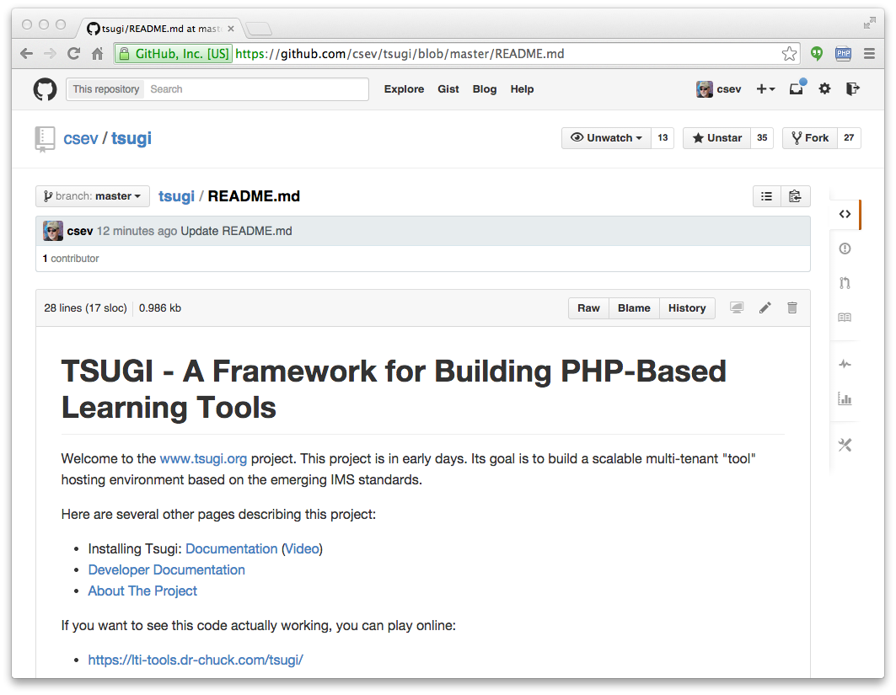
www.tsugi.org

Slide 16
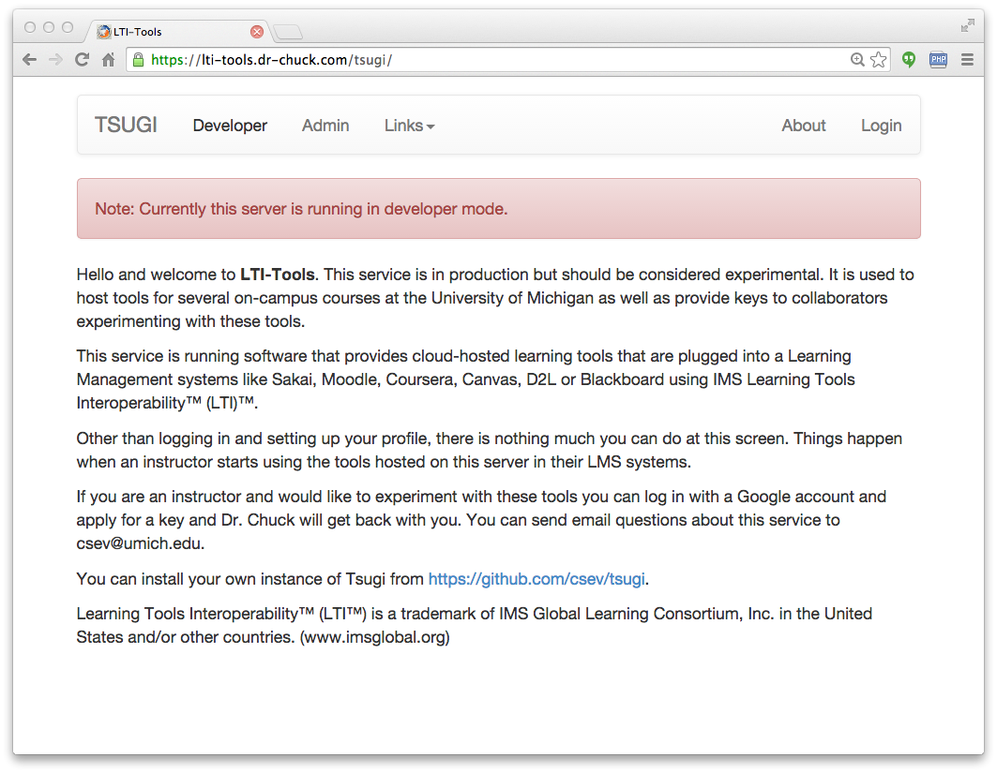

Slide 17
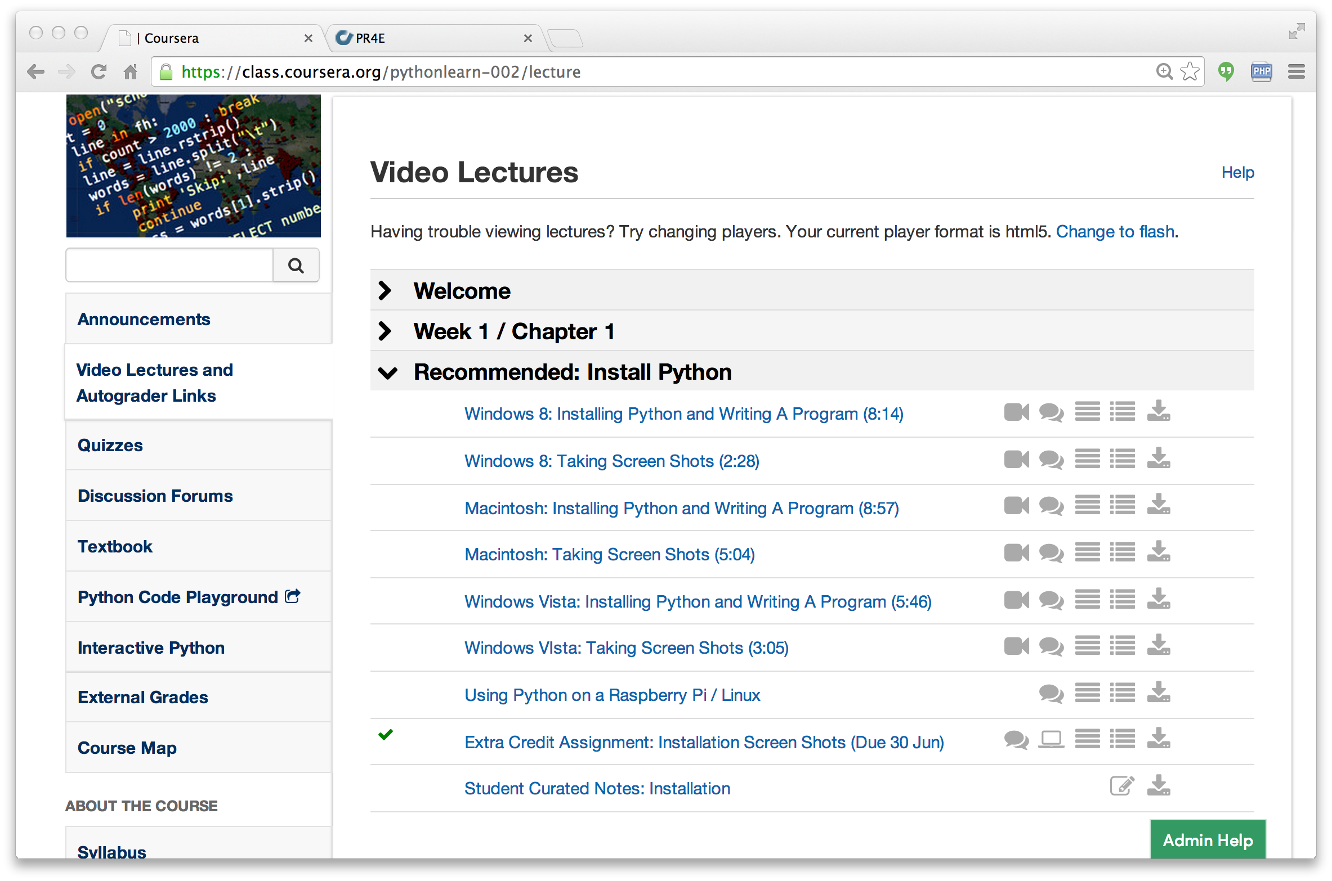

Slide 18
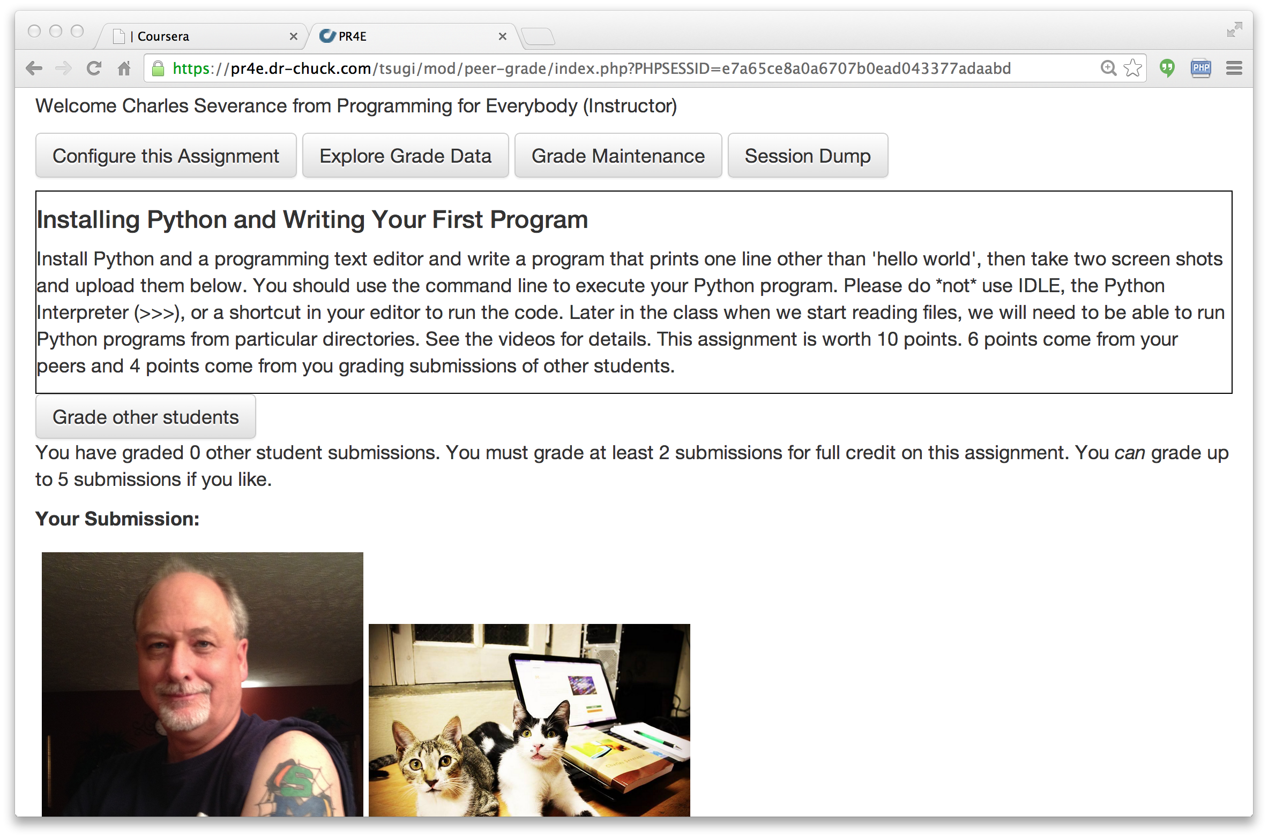

Slide 19
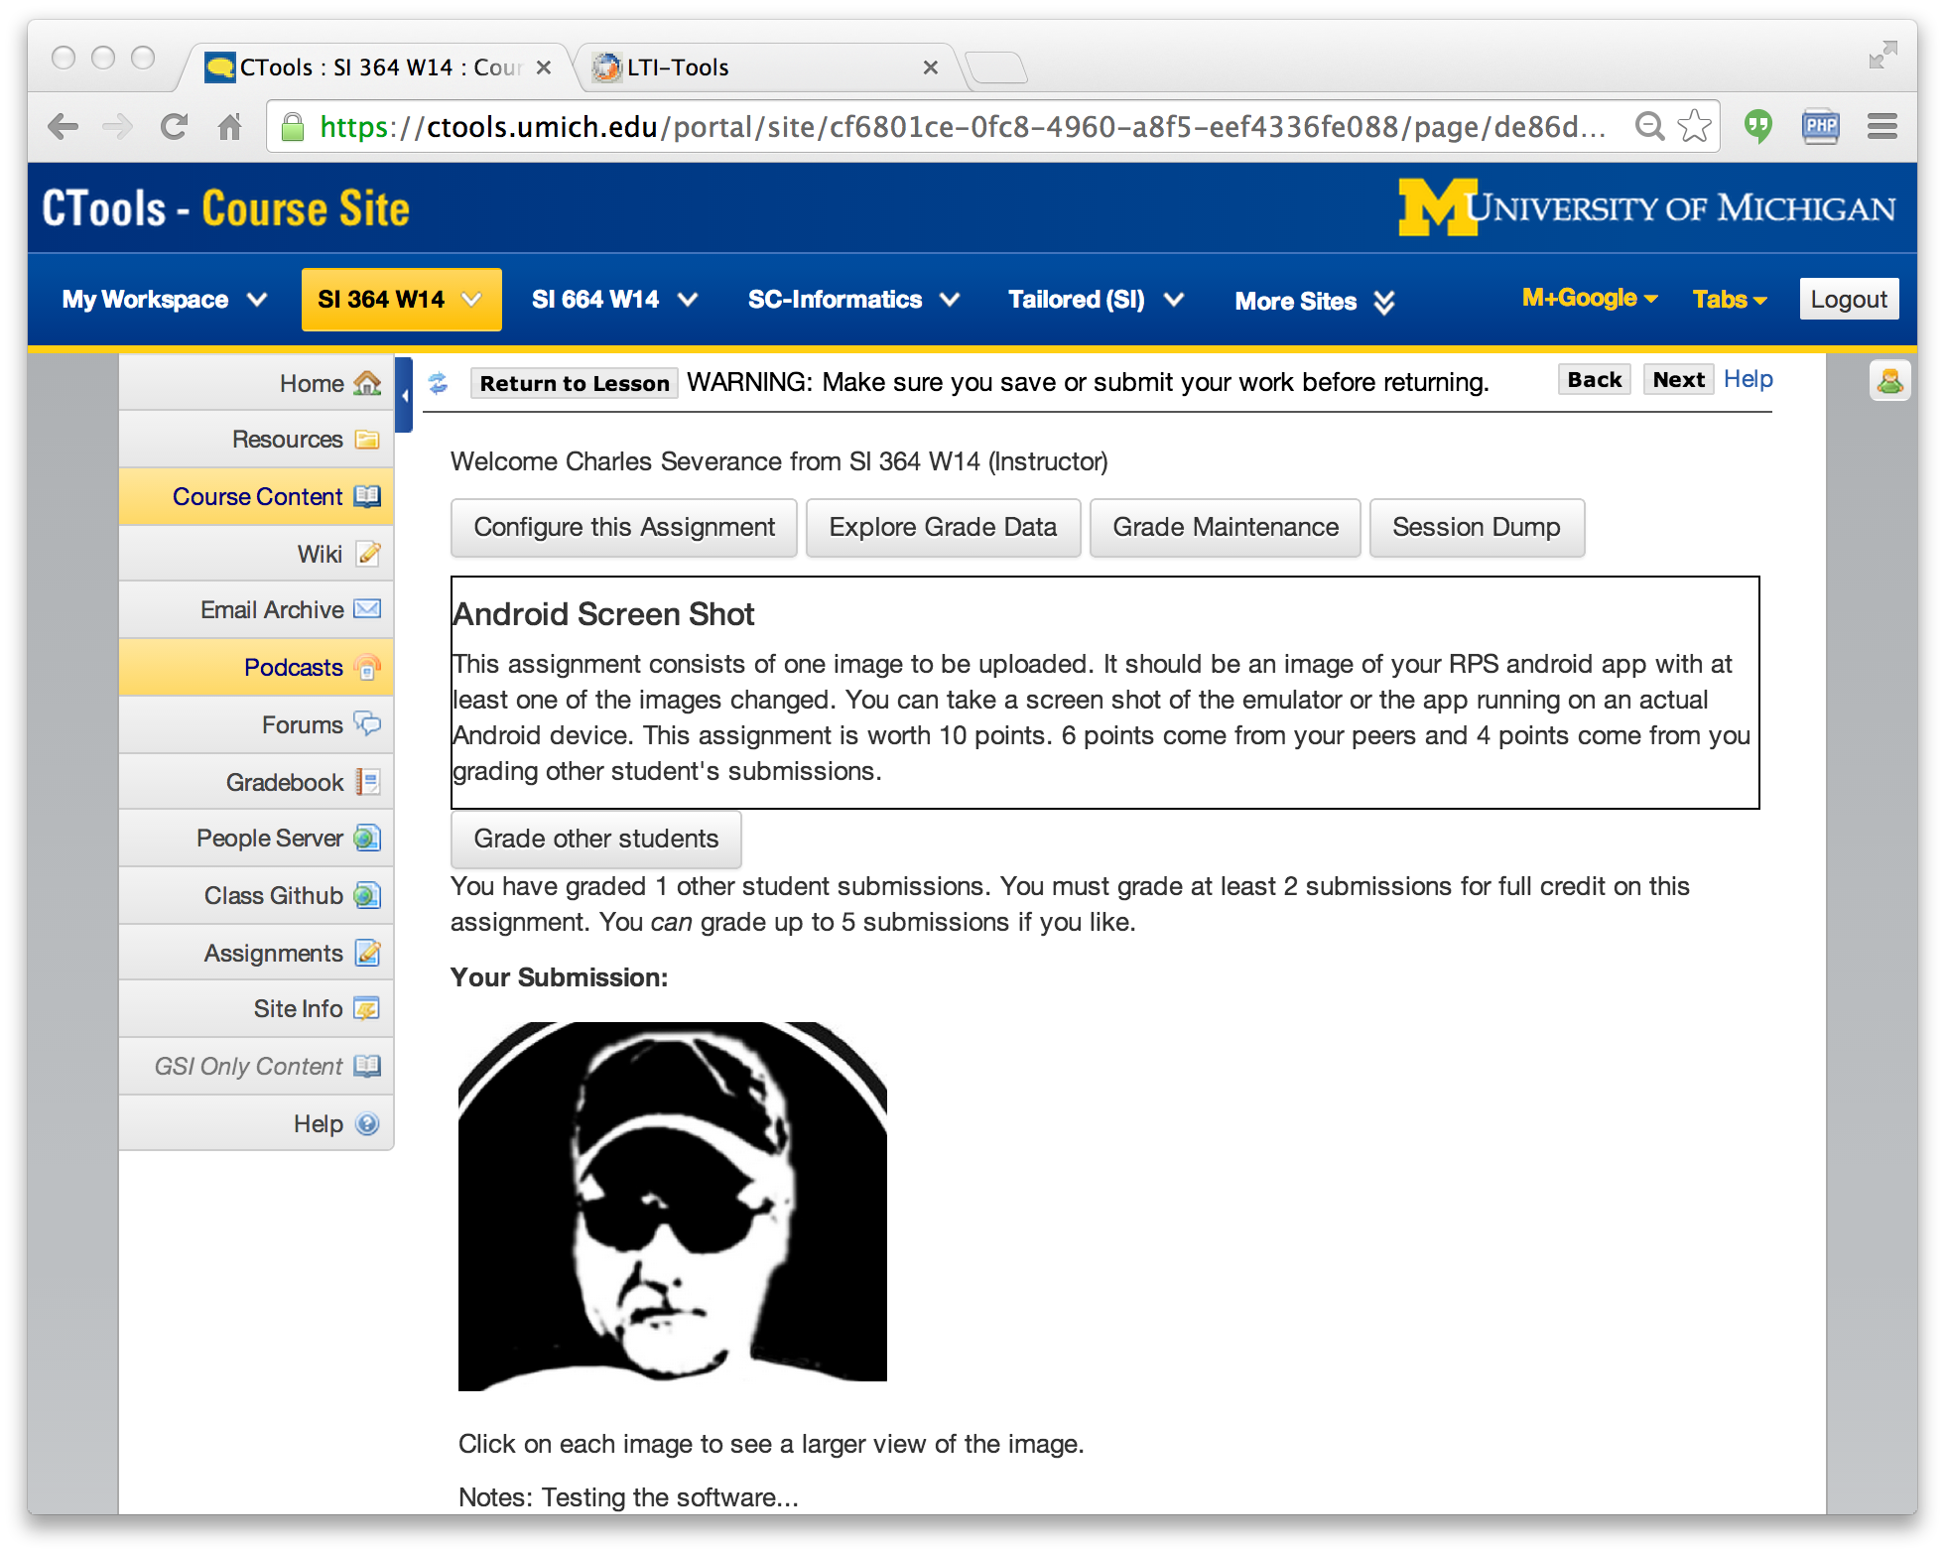

Slide 20
PHP Tsugi
Install / Configuration similar to Moodle
Emulate the Moodle APIs / Runtime
Multi-tenant
Cookie free (i.e. loves iframes)
Uses PDO with some rules about FK for easy cleanup
Auto-ddl feature to upgrade schema

Slide 21
PHP Tsugi Tool Code
<?php
require_once "../../config.php";
require_once $CFG->dirroot."/pdo.php";
require_once $CFG->dirroot."/lib/lms_lib.php";
use \Tsugi\Core\LTIX;
$LTI = LTIX::requireData(array('user_id',
'link_id', 'role','context_id'));
...
$OUTPUT->header();
$OUTPUT->bodyStart();
$OUTPUT->flashMessages();
$OUTPUT->welcomeUserCourse();
if ( $USER->instructor ) {
...

Slide 22
Demo
https://lti-tools.dr-chuck.com/tsugi/
Developer mode
Apply for keys

Slide 23
PHP Tsugi Next Steps
Tsugi 2.0 – Break into parts
IMS LTI 2.1 Support
Improve Internationalization
xAPI support
IMS Caliper Support
IMS Casa Support
Moodle Outreach?
Tsugi is in 24x7 production and I can support a few experimenters on my servers.

Slide 24
Java Tsugi
http://csev.github.io/tsugi-java/
Currently just a library and sample servlet
APIs + factory pattern
Depends on PHP Tsugi
Database table management
Developer test harness
Shares core data tables with PHP Tsugi
More to develop
Java database/key admin
Java developer console

Slide 25
Java Tsugi Tool Code
Launch launch = tsugi.getLaunch(req, res);
if ( launch.isComplete() ) return;
if ( ! launch.isValid() ) {
throw new RuntimeException(launch.getErrorMessage());
}
Output o = launch.getOutput();
Properties p = o.header(out);
out.println("<title>Sample</title>");
// Some of my CSS includes...
o.bodyStart(out);
o.navStart(out); // If you want it..
o.flashMessages(out);
out.println("<pre>");
out.println("Welcome to hello world!");
out.println("</pre>");
o.navEnd(out); // If you started it
o.footerStart(out);
// Some of my own JavaScript goodness
$(document).ready( ... );
o.footerEnd(out);

Slide 26
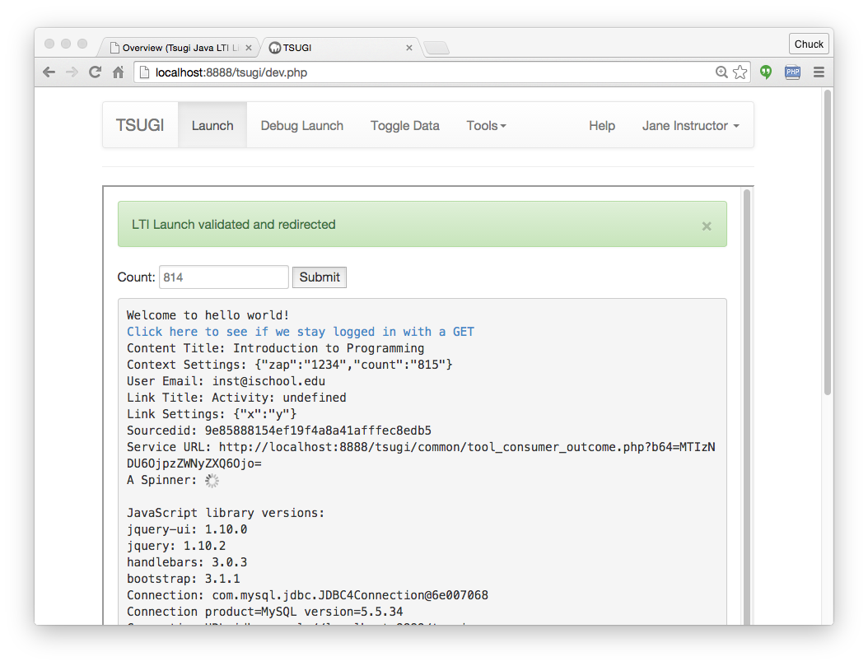

Slide 27
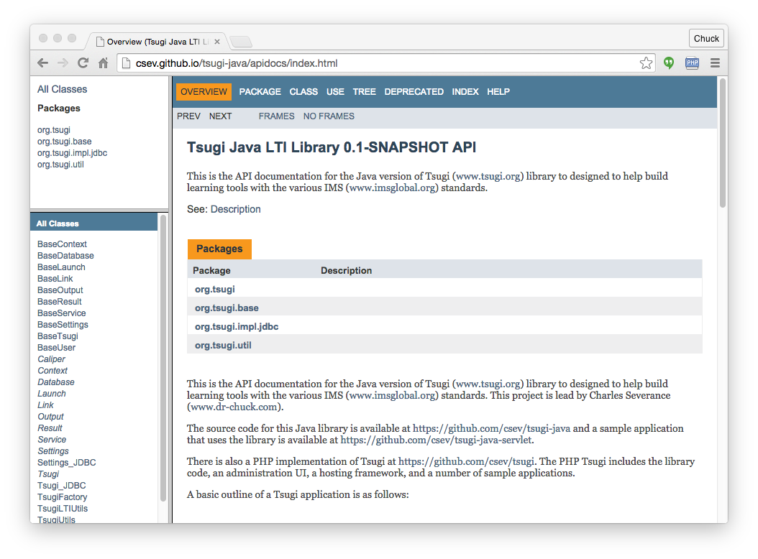

Slide 28
Deploying Java Tsugi Apps
Tomcat
Amazon
JTsugi
JTusgi
Tsugi
Tool
Tsugi
Tool
Sakai
Sakai
STsugi
Sakai
Tool
Tsugi
Tool

Slide 29
Java Tsugi Next Steps
Build out the library
Build LTI 2 registration servlet
Build administrator interface
Configure database / manage keys
Developer console
Tool hosting / installer (CASA Perhaps?)
Explore org.sakaiproject.tsugi...

Slide 30
Thank You...
www.tsugi.org

